Slide 1

CS 5/7320 Artificial Intelligence Search with Uncertainty AIMA Chapters 4.3-4.5
Slides by Michael Hahsler with figures from the AIMA textbook
This work is licensed under a Creative Commons Attribution-ShareAlike 4.0 International License.

Slide 2
Types of uncertainty we consider for now*
Nondeterministic Actions: Outcome of an action in a state is uncertain.
No observations: Sensorless problem
Partially observable environments: The agent does not know in what state it is.
Unknown environments: Online search
* we will quantify uncertainty with probabilities later.

Slide 3
Consequence of Uncertainty
Remember: The solution for the known maze was a fixed sequence of actions from start to goal.
With uncertainty: Solution is not a precomputed sequence, but a conditional plan (a strategy or policy) that depends on percepts.

Slide 4

Nondeterministic Actions

Slide 5
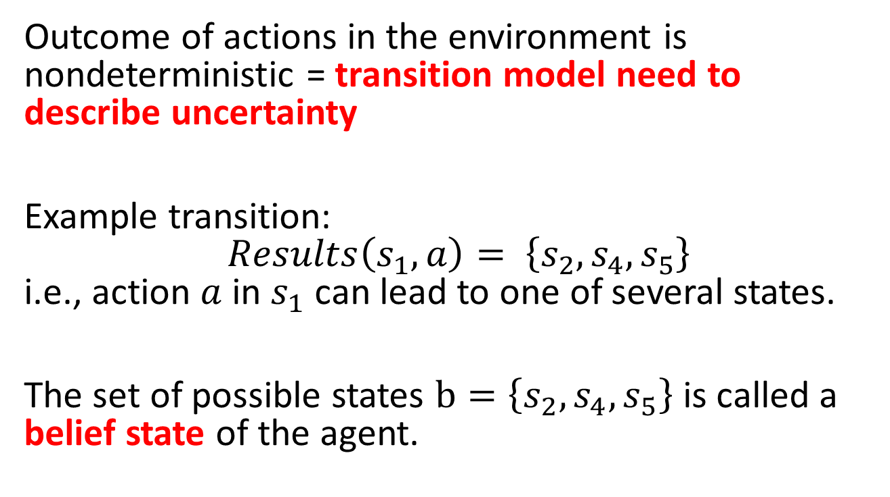
Nondeterministic Actions
Outcome of actions in the environment is nondeterministic = transition model need to describe uncertainty
Example transition: $Results\left(s_{1},a\right)= \left\{s_{2},s_{4},s_{5}\right\}$ i.e., action $a$ in $s_{1}$ can lead to one of several states.
The set of possible states $b=\left\{s_{2},s_{4},s_{5}\right\}$ is called a belief state of the agent.

Slide 6

Example: Erratic Vacuum World
Regular vacuum world, but the action ‘suck’ is more powerful and nondeterministic:
On a dirty square: cleans the square and sometimes cleans dirt on adjacent squares as well.
On a clean square: sometimes deposits some dirt on the square.

Slide 7
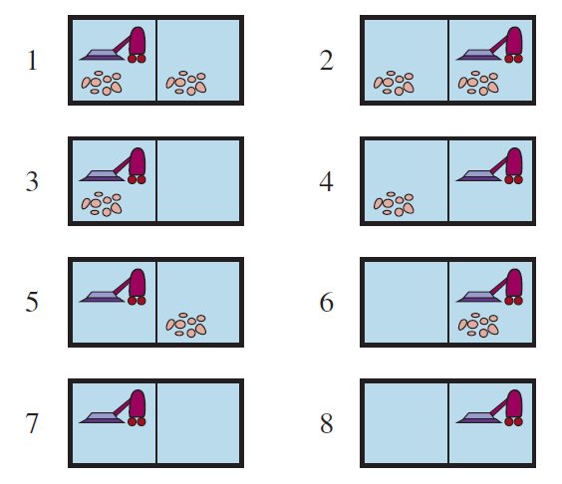
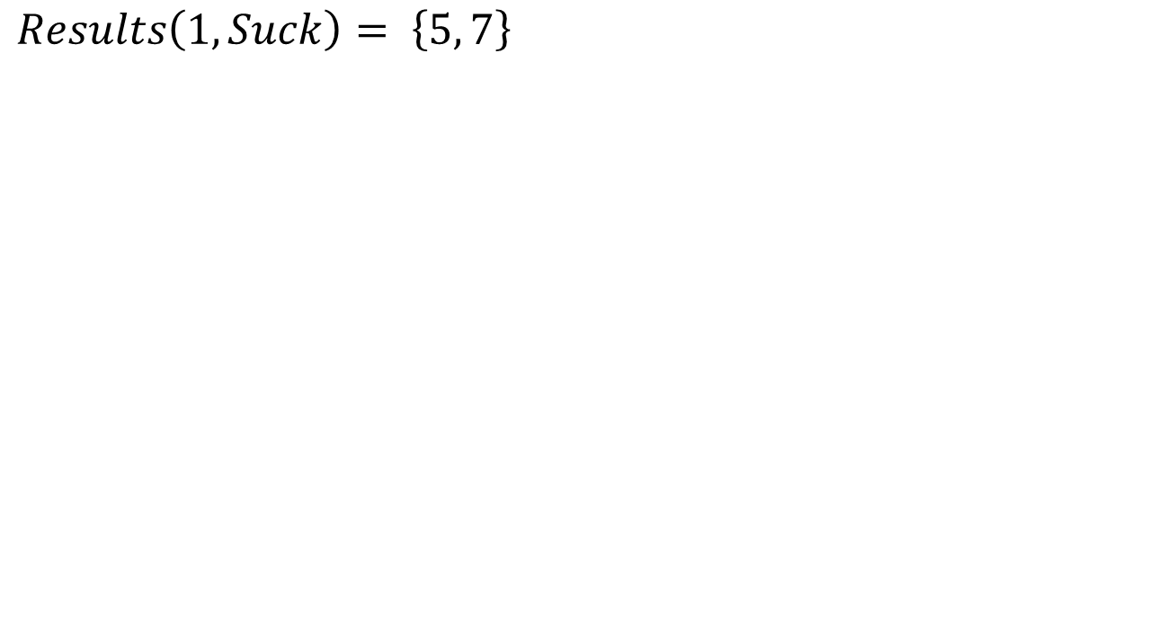
Example: Erratic Vacuum World
$Results\left(1, Suck\right)= \left\{5, 7\right\}$
Goal states
We need a conditional plan
[Suck, if State = 5 then [Right, Suck] else []]

Slide 8
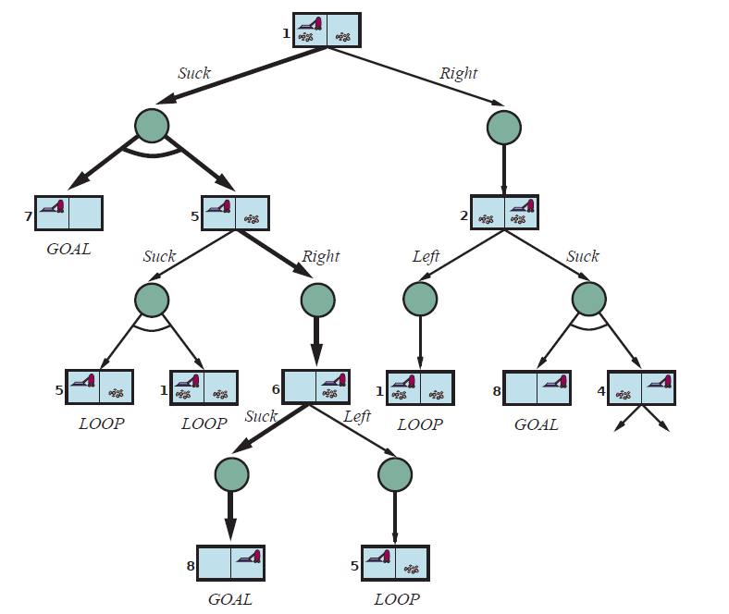
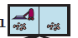

AND-OR Search Tree
Suck
OR node (choose action)
AND node (possible outcomes)
Right
Solution:
subtree that has only GOAL leaf nodes
Specifies one action at each OR node (state)
Includes every outcome of AND nodes
Solution is shown with bold arrows:
[Suck, if State = 5 then [Right, Suck] else []]
Suck
LOOP: No need to continue search. Solution is the same as above.

Slide 9
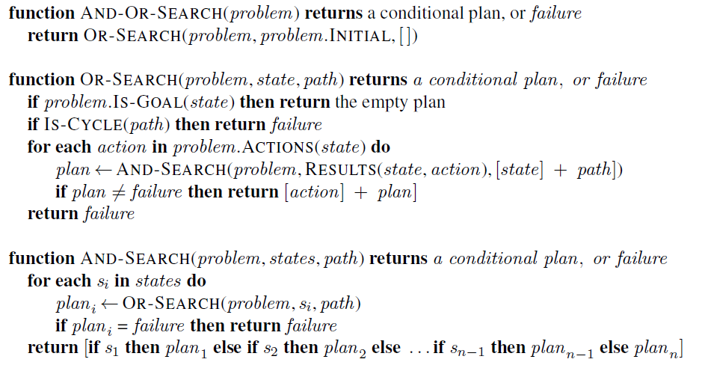
AND-OR Recursive DFS Algorithm
= nested If-then-else statements
path is only maintained for cycle checking!
// don’t follow loops using path.
// try all possible actions
// try all possible outcomes, none can fail! // (= belief state)
Notes:
The DFS search tree is implicitly created using the call stack.
DFS is not optimal! BFS and A* search can be used to find the optimal solution.

Slide 10
Use of Conditional Plans
The conditional plan can be used in a model-based reflex agent.
Example: After the initial action “suck”
Agent
Step
Program
1
[Suck,
if State = 5 then
[Right,
Suck]
else
[]
]
2
State
3
Step 2
4
4b

Slide 11

Search with no Observations

Slide 12
No Observations
Sensorless problem = conformant problem
Example: Doctor prescribes a broad-band antibiotic instead of performing time-consuming blood work for a more specific antibiotic. This saves time and money.
Basic idea: Find a solution (a sequence of actions) that works from any state and then just blindly execute it (called open loop system).

Slide 13
Actions to Coerce the World into States
Actions can reduce the number of possible states.
Example: Deterministic vacuum world. Agent does not know its position and the dirt distribution.
Initial belief state {1,2,3,4,5,6,7,8}
right
Goal states

Slide 14
Actions to Coerce the World into States
Actions can reduce the number of possible states.
Example: Deterministic vacuum world. Agent does not know its position and the dirt distribution.
suck

Slide 15
Actions to Coerce the World into States
The action sequence [right, suck, left, suck] coerces the world into the goal state 7.
This works from any initial state and there is no need for a conditional plan!
[right, suck, left, suck]

Slide 16
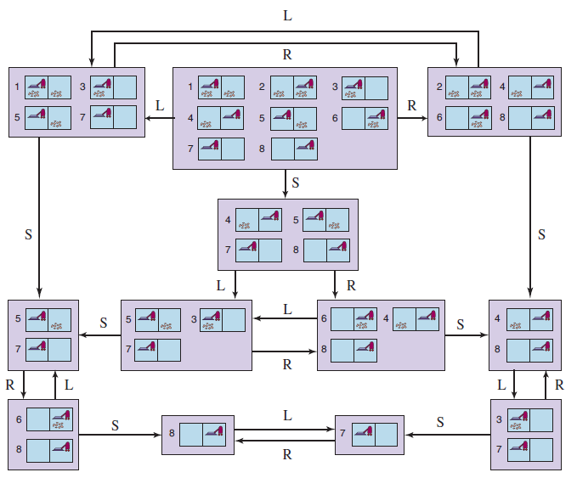
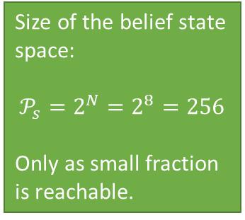
Example: The reachable belief-state space for the deterministic, sensorless vacuum world
Size of the belief state space:
$$𝒫_{s}=2^{N}=2^{8}=256$$
Only as small fraction is reachable.
Initial belief state
Solution Sequence:
[right, suck, left, suck]

Slide 17
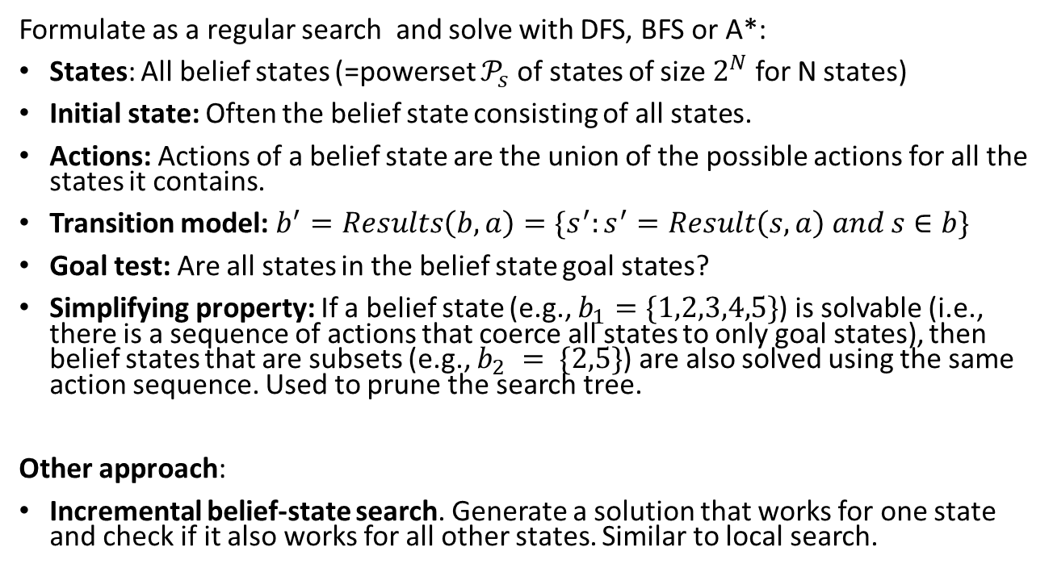
Finding a Solution Sequence
Note: State space size makes this impractical for larger problems!
Formulate as a regular search and solve with DFS, BFS or A*:
States: All belief states (=powerset $𝒫_{s}$ of states of size $2^{N}$ for N states)
Initial state: Often the belief state consisting of all states.
Actions: Actions of a belief state are the union of the possible actions for all the states it contains.
Transition model: $b^{′}=Results\left(b, a\right)=\{s^{′}:s^{′}=Result\left(s, a\right) and s∈b\}$
Goal test: Are all states in the belief state goal states?
Simplifying property: If a belief state (e.g., $b_{1}=\{1,2,3,4,5\}$) is solvable (i.e., there is a sequence of actions that coerce all states to only goal states), then belief states that are subsets (e.g., $b_{2} = \{2,5\}$) are also solved using the same action sequence. Used to prune the search tree.
Other approach:
Incremental belief-state search. Generate a solution that works for one state and check if it also works for all other states. Similar to local search.

Slide 18

Partially Observable Environments

Slide 19

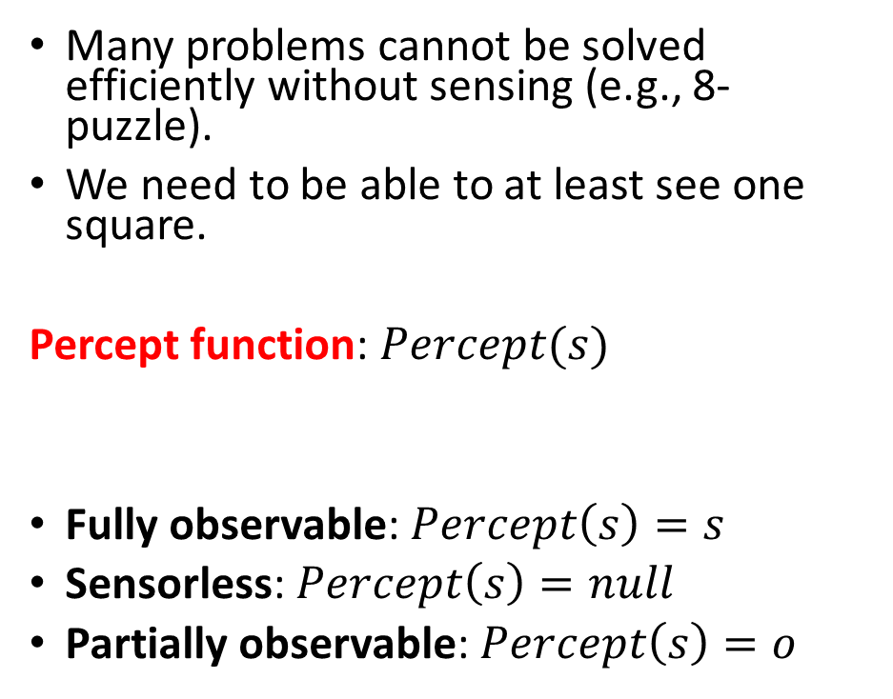
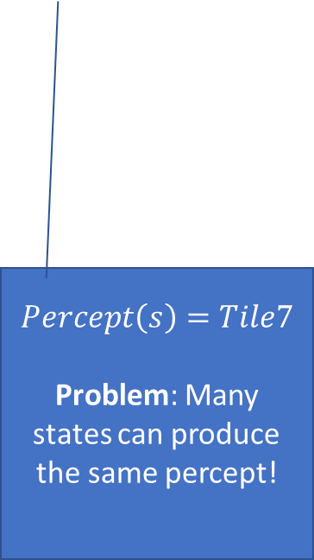
Percepts
Many problems cannot be solved efficiently without sensing (e.g., 8-puzzle).
We need to be able to at least see one square.
Percept function: $Percept(s)$
Fully observable: $Percept\left(s\right)=s$
Sensorless: $Percept\left(s\right)=null$
Partially observable: $Percept\left(s\right)=o$
$$Percept\left(s\right)=Tile7$$
Problem: Many states can produce the same percept!

Slide 20
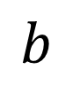
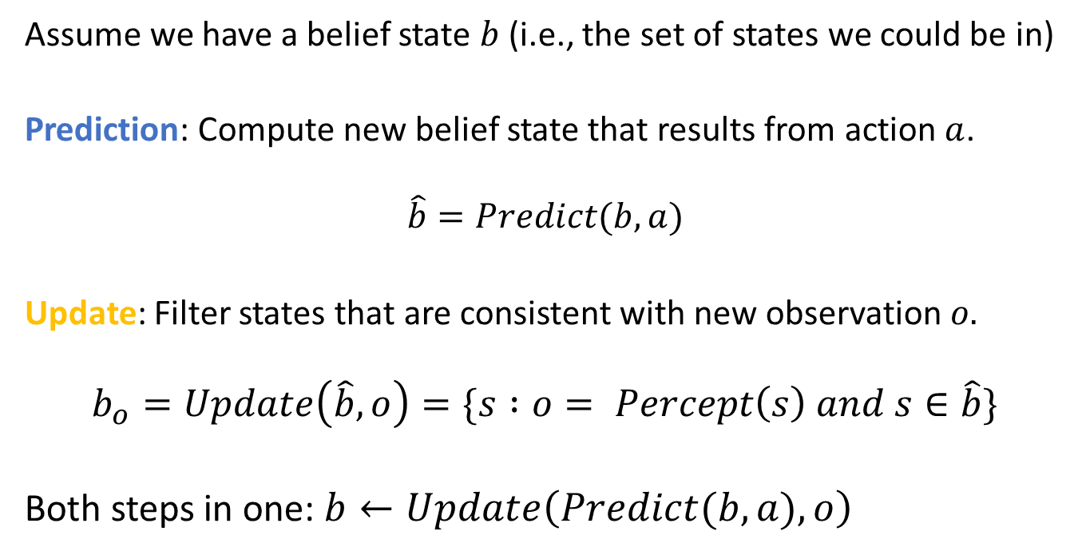
Prediction and Update
Prediction for action
Update with observation
$$b$$
Assume we have a belief state $b$ (i.e., the set of states we could be in)
Prediction: Compute new belief state that results from action $a$.
$$\hat{b}=Predict(b,a)$$
Update: Filter states that are consistent with new observation $o.$
$$b_{o}=Update\left(\hat{b},o\right)=\{s :o= Percept\left(s\right) and s∈\hat{b}\}$$
Both steps in one: $b←Update\left(Predict(b,a),o\right)$

Slide 21
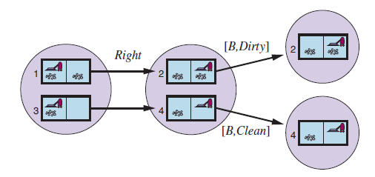

Example: Deterministic local sensing vacuum world
Prediction for action
Update with observation
$$b$$
Predict for actions
Update with observation
[R,Dirty]
[L,Dirty]
$$b←Update\left(Predict(b,a),o\right)$$
$$Update\left(Predict\left(\left\{1,3\right\},Right\right),[R.Dirty]\right)=\{2\}$$

Slide 22
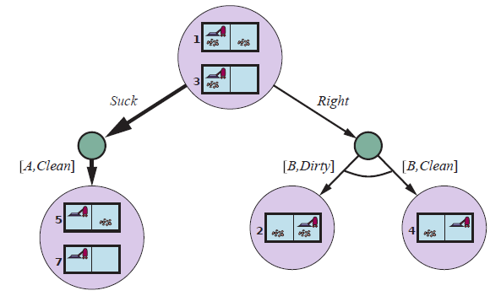
Solving Partially Observable Problems
Use an AND-OR tree to create a conditional plan
predict
OR
update
[L,Clean]
AND
[R,Dirty]
[R,Clean]
AND
Solution: [Suck, Right, if b = {6} then Suck else []]

Slide 23
Solving Partially Observable Problems
Use an AND-OR tree to create a conditional plan
predict
OR
update
[L,Clean]
AND
[R,Dirty]
[R,Clean]
AND
Solution: [Suck, Right, if b = {6} then Suck else []]

Slide 24
Solving Partially Observable Problems
Use an AND-OR tree to create a conditional plan
predict
OR
update
[L,Clean]
AND
[R,Dirty]
[R,Clean]
AND
…
Solution: [Suck, Right, if b = {6} then Suck else []]

Slide 25
Solving Partially Observable Problems
Use an AND-OR tree to create a conditional plan
predict
OR
update
[L,Clean]
AND
[R,Dirty]
[R,Clean]
AND
…
Solution: [Suck, Right, if b = {6} then Suck else []]
Note: Belief states that are subsets can be used for pruning!

Slide 26
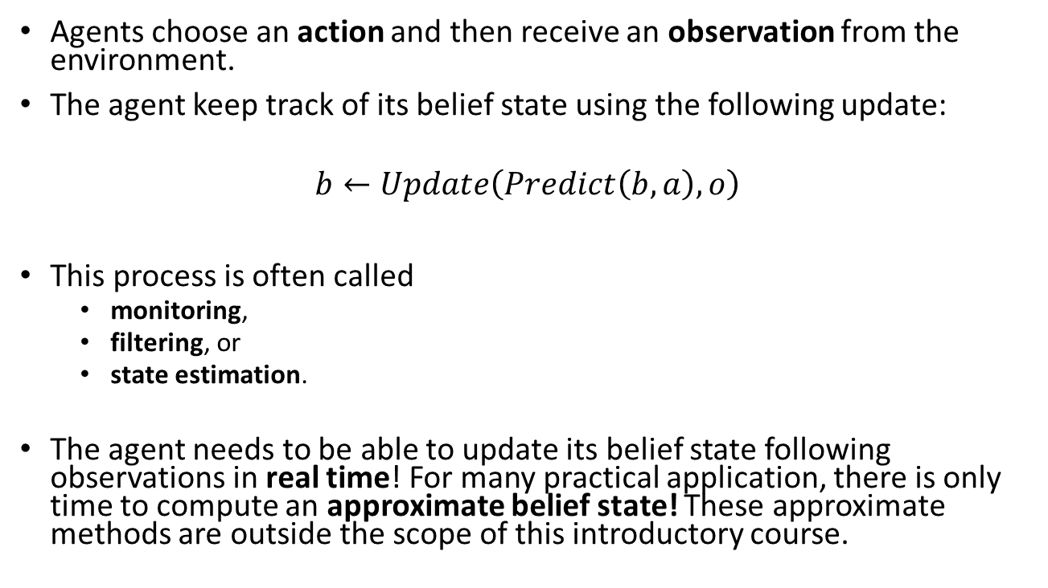
State Estimation and Approximate Belief States
Agents choose an action and then receive an observation from the environment.
The agent keep track of its belief state using the following update:
$$b←Update\left(Predict\left(b,a\right),o\right)$$
This process is often called
monitoring,
filtering, or
state estimation.
The agent needs to be able to update its belief state following observations in real time! For many practical application, there is only time to compute an approximate belief state! These approximate methods are outside the scope of this introductory course.

Slide 27
Case Study
Partially Observable 8-Puzzle

Slide 28
Partially Observable 8-Puzzle
How do we solve this problem? What are the main steps?
Give a problem description for each step.
States:
Initial state:
Actions:
Transition model:
Goal test:
Percept function:
What algorithms can be used?

Slide 29

Unknown Environment
Online Search

Slide 30
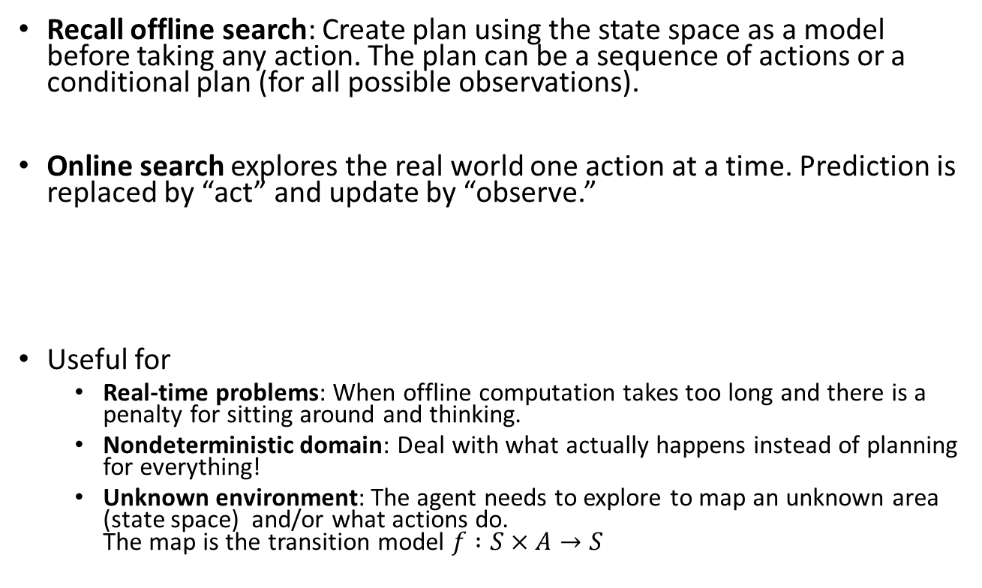
Online Search
Recall offline search: Create plan using the state space as a model before taking any action. The plan can be a sequence of actions or a conditional plan (for all possible observations).
Online search explores the real world one action at a time. Prediction is replaced by “act” and update by “observe.”
Useful for
Real-time problems: When offline computation takes too long and there is a penalty for sitting around and thinking.
Nondeterministic domain: Deal with what actually happens instead of planning for everything!
Unknown environment: The agent needs to explore to map an unknown area (state space) and/or what actions do. The map is the transition model $f :S×A→S$
Act
Observe
Observe
Act
Act
…

Slide 31
Issues With Online Search
Knowledge: What does the agent know about the outcome of actions? E.g., does go north and then south lead to the same location?
Safely explorable state space/world: There are no irreversible actions that cannot be undone (e.g., traps, cliffs). At least the agent does not execute these actions.
Expanding nodes in local order is more efficient:
Depth-first search with backtracking

Slide 32
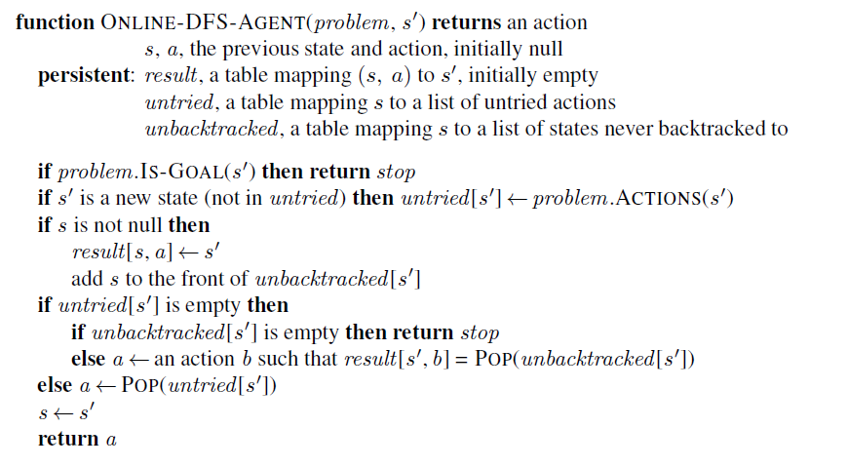
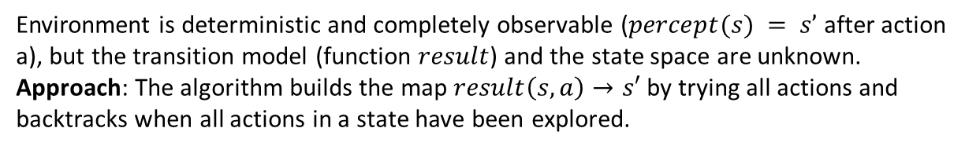
Online Search: Agent Program for Unknown Transition model
Environment is deterministic and completely observable ($percept(s) = s’$ after action a), but the transition model (function $result$) and the state space are unknown.
Approach: The algorithm builds the map $result\left(s, a\right)→s′$ by trying all actions and backtracks when all actions in a state have been explored.
Learns results and uses it for backtracking
// unbacktracked leaves a “breadcrumb trail”

Slide 33

Important concepts that you should be able to explain and use now…
Difference between the solution types:
a fixed actions sequence, and
a conditional plan (also called strategy or policy).
What are belief states?
How actions can be used to coerce the world into states.
State estimation with repeated predict and update steps.
The use of AND-OR trees.

